Slide 1
PDAS_ST1503
CA2 Presentation
Lee Hong Yi
p2223010
DAAA/FT/1B/05
How does humidity and temperature affect the amount of dengue cases?

Slide 2
Xiao Wen has been asked by NEA to analyze how weather has affected the amount of dengue cases in Singapore. More specifically, he has been asked to analyze how humidity and temperature affect the number of dengue cases. He has asked to do this analysis, so that the government can see how the spread of dengue can be reduced.
Storyline regarding analysis.

Slide 3
Due to the nature at which the Dengue virus is transmitted, the actual goal of the analysis is not to see how temperature and humidity affect the spread of the disease, but instead finding out which temperatures and humidities are most conducive for the breeding of the Aedes mosquito.
Using information gathered from research on the Aedes mosquito, it can be seen that a mosquito only becomes infective with the Dengue virus approximately 7 days after it has bitten a infected individual. Furthermore, as a newly hatched Aedes egg takes 6-7 days to grow into a adult, eggs laid by a Aedes mosquito will take 13-14 days to go from birth to being able to transmit the Dengue disease.
Hence, the data for the dengue case count has to be delayed by 14 days, so that a accurate analysis on the most conducive weather for the breeding of the Aedes mosquito can be determined.
In summary, the actual analysis is on which temperatures and humidities are the most conducive for the breeding of the Aedes mosquito in Singapore.
Disclaimer.

Slide 4
What is analysed.
Xiao Wen then analyzed the following datasets:
Meteorological data from Ang Mo Kio from 2014 to 2020.
Meteorological data from Tuas South from 2014 to 2020.
Meteorological data from Changi from 2014 to 2020.
Air Temperature And Sunshine, Relative Humidity And Rainfall, Monthly
Weekly Infectious Disease Bulletin
From here, he would like to find out the following:
What is the most optimum conditions for dengue to breed in Singapore.
What can be done to help reduce this spread.

Slide 5
Nature of datasets
Dataset 1 - angmokio.csv Dataset 2 - changi.csv Dataset 3 -tuassouth.csv | station - which weather station was the weather taken from
 | year - year which data was taken
 | month - month which data was taken
 | day - day which data was taken
 | Daily Rainfall Total (mm) - total rainfall for the day
 | Highest 30 min Rainfall (mm) - max rainfall in 30 minutes
 | Highest 60 min Rainfall (mm) - max rainfall in 60 minutes
 | Highest 120 min Rainfall (mm) - max rainfall in 120 mins
 | Mean Temperature (°C) - mean temperature for the day
 | Maximum Temperature (°C) - max temperature for the day
 | Maximum Temperature (°C) - min temperature for the day
 | Mean Wind Speed (km/h) - mean wind speed for the day
 | Max Wind Speed (km/h) - max wind speed for the day

Slide 6
Nature of datasets
Dataset 4 - M890081.xlsx | Air Temperature Means Daily Maximum (Degree Celsius)
 | Air Temperature Means Daily Minimum (Degree Celsius)
 | Air Temperature Absolute Extremes Maximum (Degree Celsius)
 | Air Temperature Absolute Extremes Minimum (Degree Celsius)
 | Total Rainfall (Millimetre)
 | Highest Daily Rainfall Total (Millimetre)
 | Number Of Rainy Days (Number)
 | Bright Sunshine Daily Mean (Hour)
 | Minimum Relative Humidity (Per Cent)
 | 24 Hours Mean Relative Humidity (Per Cent)

Slide 7
Nature of datasets
Dataset 5 - weekly-infectious-disease-bulletin-cases.csv | epi_week - epidemiological week where data was taken
 | disease - name of disease logged
 | no.-_of_cases - number of cases logged for the disease.

Slide 8
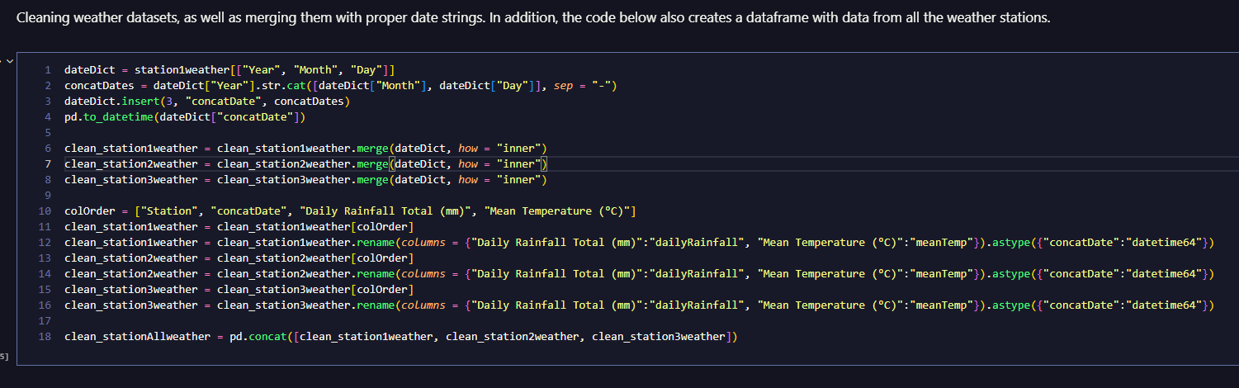
Data cleaning (Datasets 1/2/3)

Slide 9
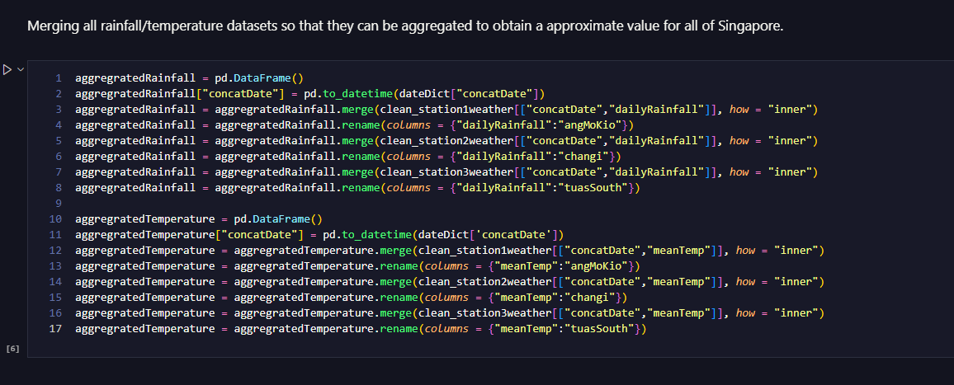
Data cleaning (Datasets 1/2/3)

Slide 10
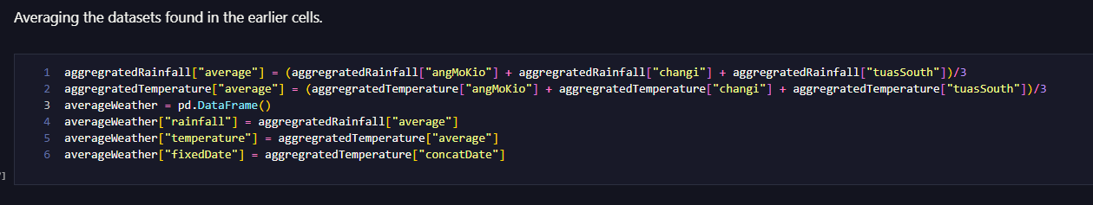
Data cleaning (Datasets 1/2/3)

Slide 11
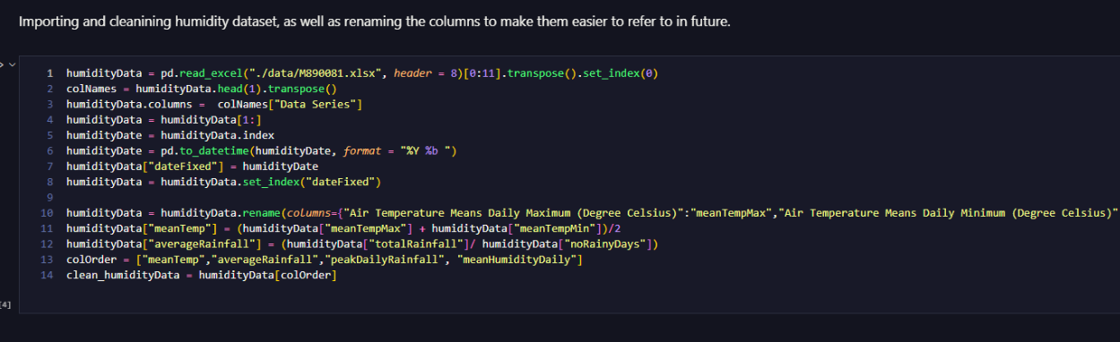
Data cleaning (Dataset 4)

Slide 12
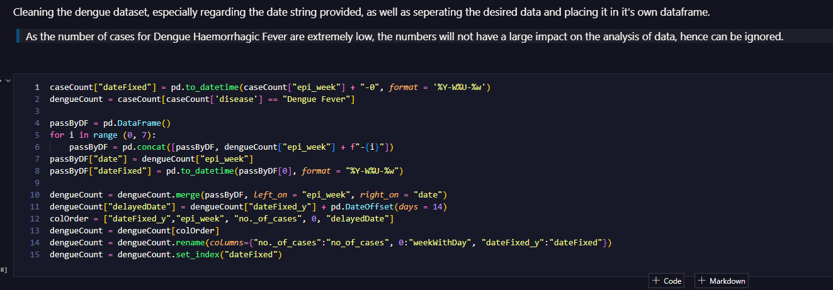
Data cleaning (Dataset 5)

Slide 13
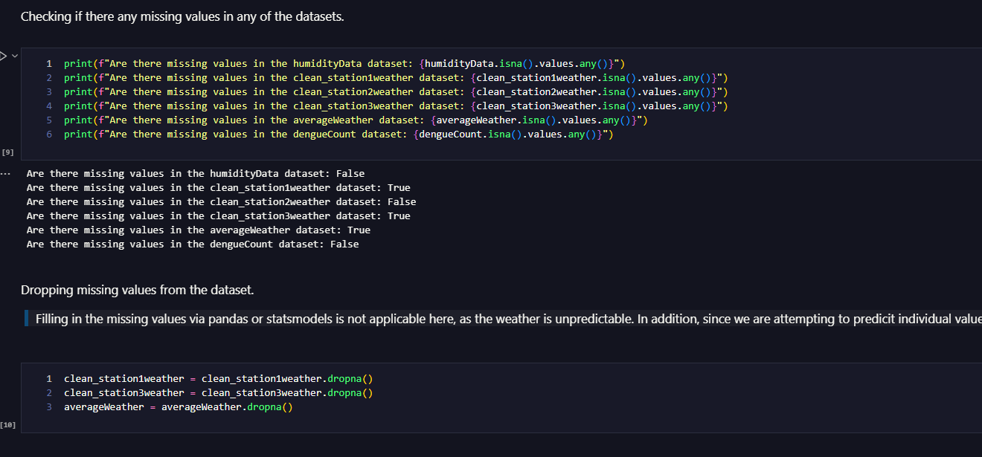
Checking for missing values
Filling in the missing values via pandas or statsmodels is not applicable here, as the weather is unpredictable. In addition, since we are attempting to predict individual values, and not attempting to determine a trend to fill in the missing values, it is thus better to drop the missing data instead.

Slide 14
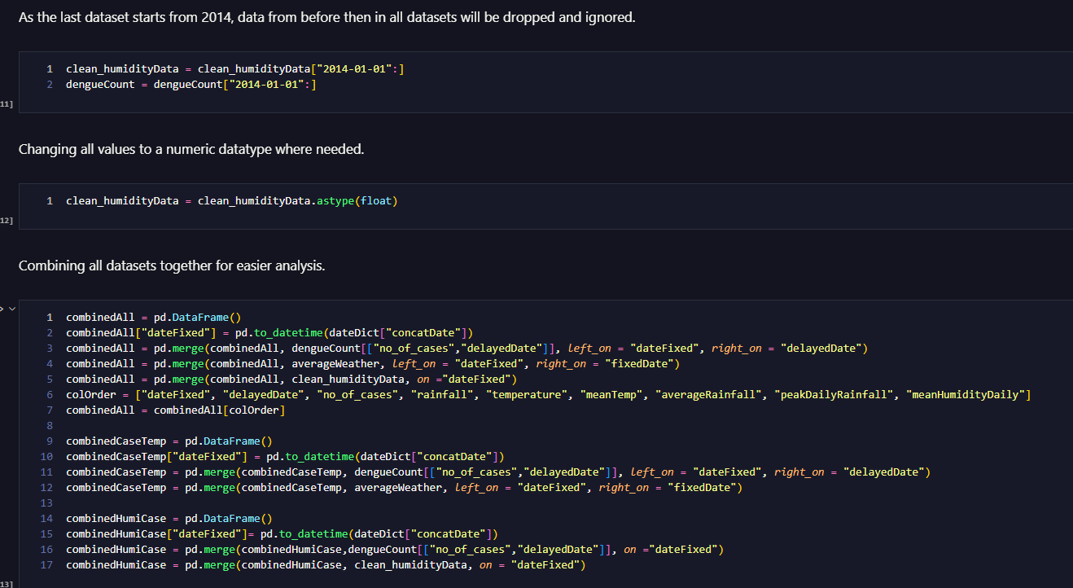
Finalizing Datasets.

Slide 15
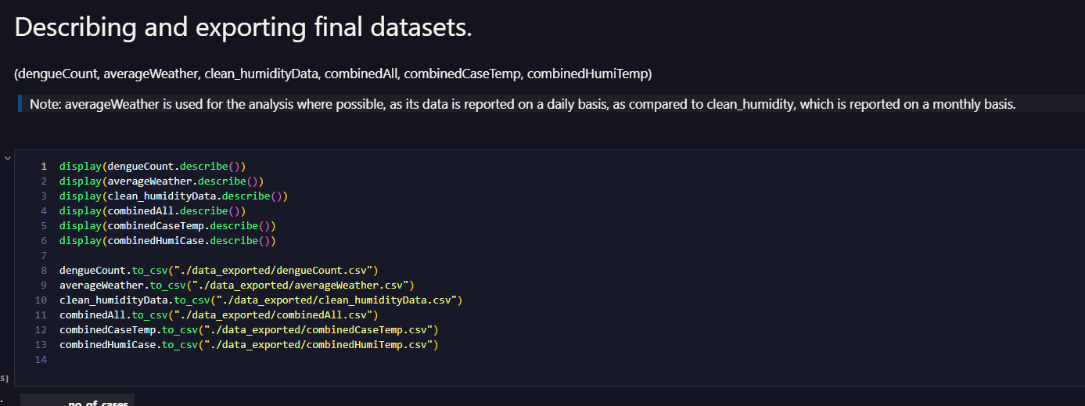
Describing Datasets

Slide 16
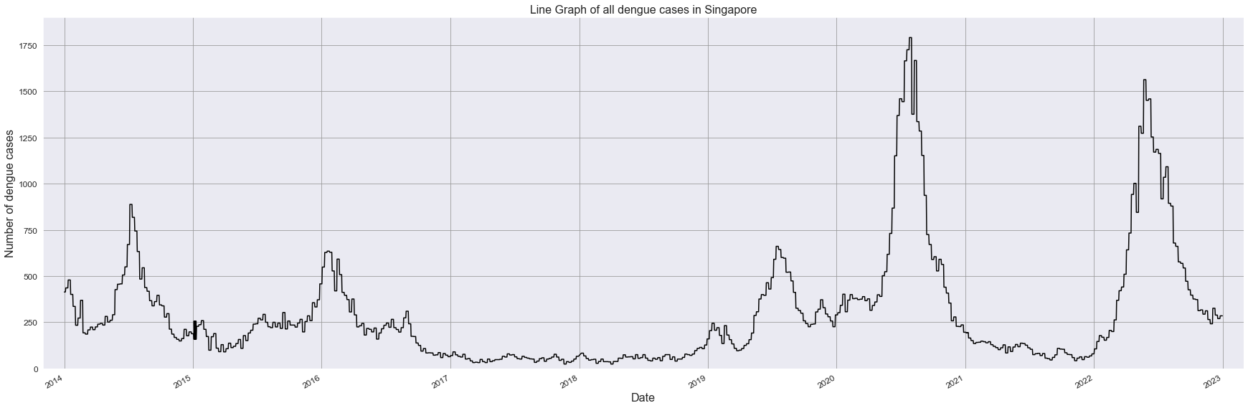
Graph 1 - Graph of all dengue cases in Singapore
From the above line graph, we can see that the number of dengue cases in Singapore has been on the rise, with two recent spikes lately, in 2020 and 2022. Aside from these, there was a lull in cases from 2017 to 2019.

Slide 17
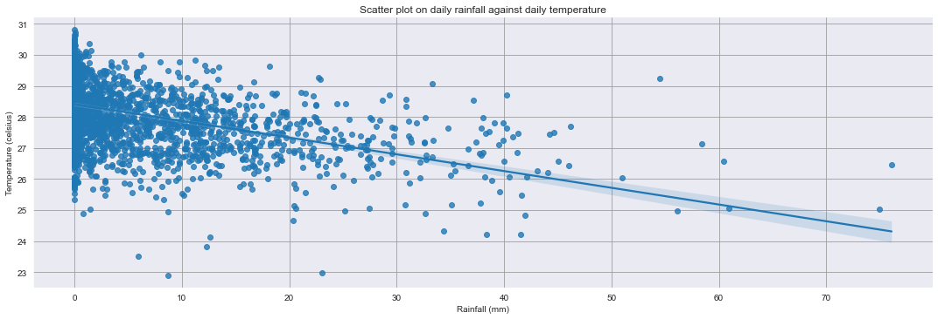
Graph 2 - Scatter plot on rainfall against temperature
From the above graph, we can see that there is a correlation between rainfall and temperature, with increasing rainfall resulting in lower temperatures. In addition, there are also a few days where there were high rainfall, with high temperatures. These days are outliers, however cannot be excluded from the analysis.

Slide 18
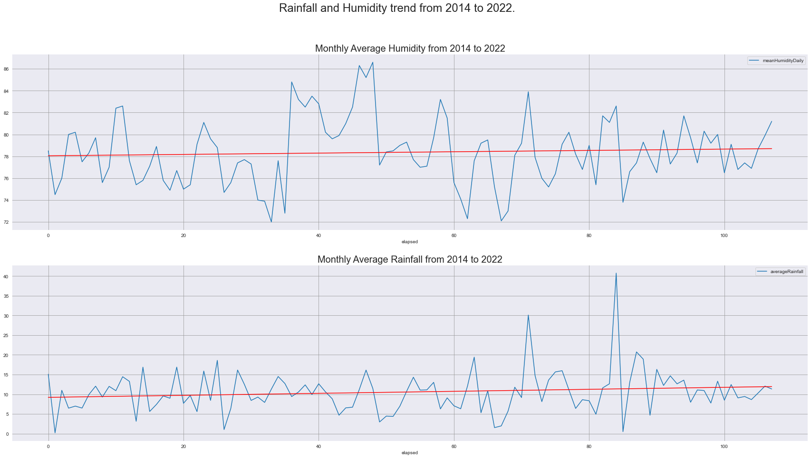
Graph 3 - Rainfall and Humidity trend from 2014 to 2022
Gradient of humidity best-fit line: 0.006082864138252948
Gradient of rainfall best-fit line: 0.025485070801155203
From the graph, we can see that humidity and rainfall has been increasing, albeit at a slower rate than expected. There are years where humidity was higher than the trend, despite rainfall remaining at a low amount.

Slide 19
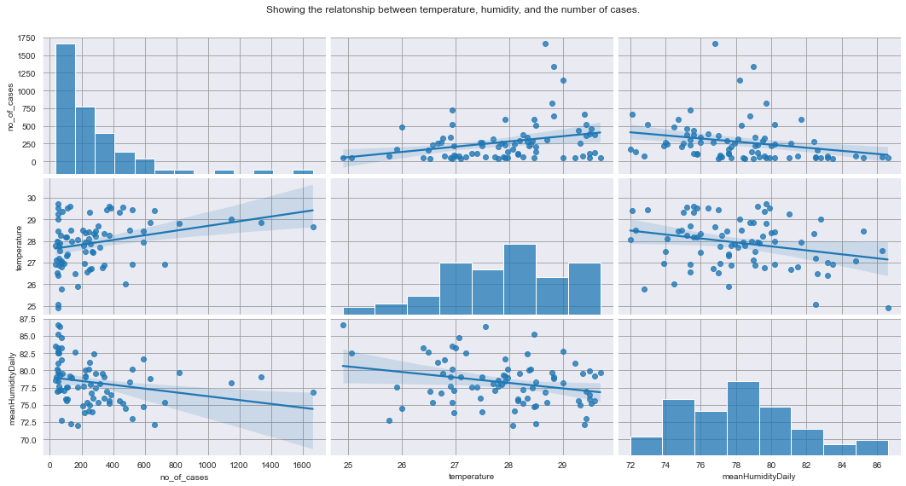
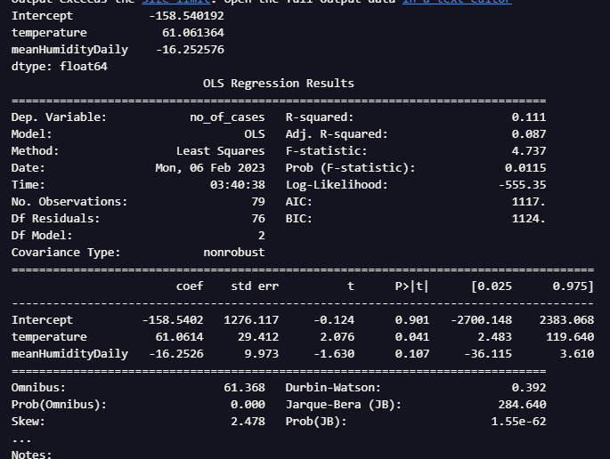
Graph 4 - Showing the relationship between temperature, humidity, and the number of cases.

Slide 20
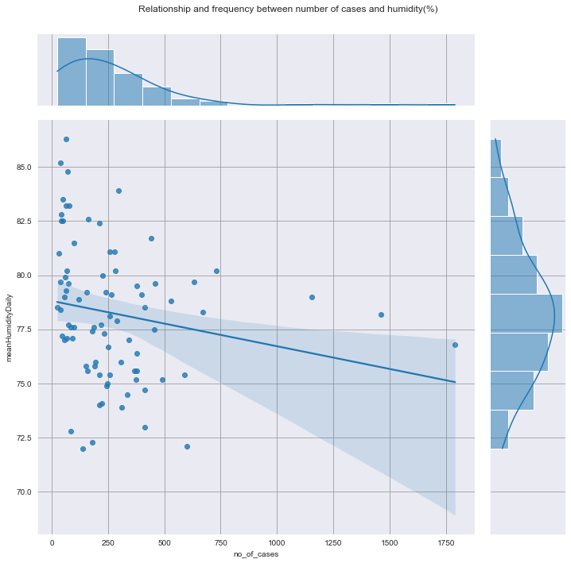
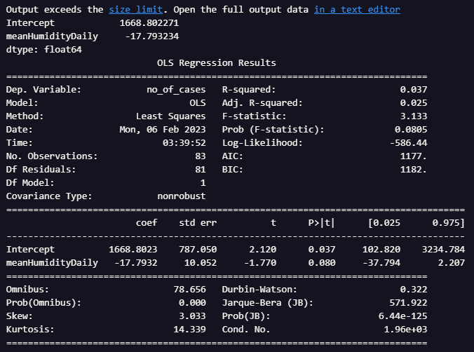
Graph 5 - Relationship and frequency between number of cases and humidity(%)

Slide 21
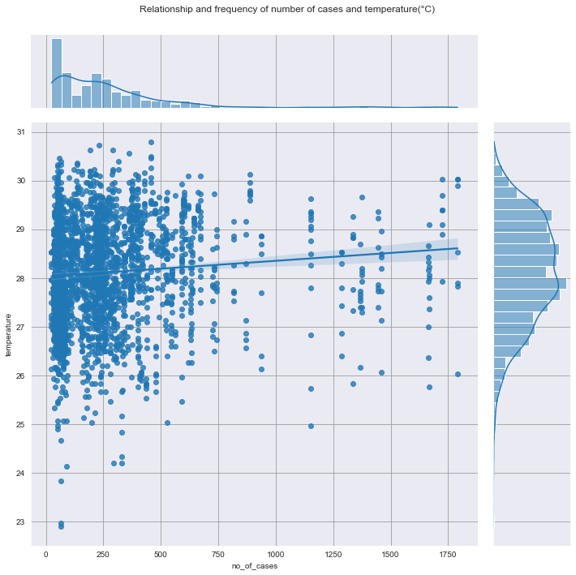
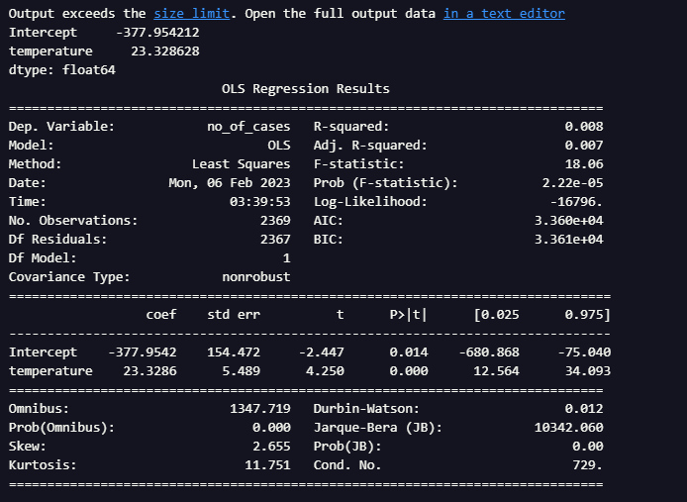
Graph 6 - Relationship and frequency of number of cases and temperature(°C)

Slide 22
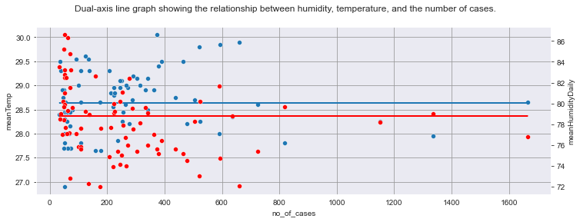
Graph 9 - Dual-axis line graph showing the relationship between humidity, temperature, and the number of cases.
Gradient of best-fit line for cases compared to temperature is 0.0001291936578885731
Gradient of best-fit line for cases compared to humidity is -0.0027683006517716896
From the graph above, we can see that there is no sweet spot or clear correlation between humidity, temperature and the number of dengue cases in Singapore.

Slide 23
Final conclusions.
Using the linear regression models created above, we can see that the correlation between humidity, temperature, and the number of cases are relatively weak in Singapore. From online research conducted, we can see that the optimum range for the Aedes mosquito to breed is between 27 and 29.5 degrees celsius, and when humidity is above 75%. As we can see from the data plotted above, we can see that Singapore is almost constantly within this weather range. Hence, we can conclude that as Singapore is almost within these range of conditions, there is no "optimum" range for the Aedes mosquito to breed in Singapore, as the rate at which they can breed is already at optimum.
Due to these findings, Xiao Wen’s conclusion is as follows:
As the weather does not play a factor in regards to the breeding of the Aedes mosquito in Singapore, the government can engage in more aggressive tactics to reduce the number of Aedes mosquitos, such as fumigation, releasing of Wolbachia infected mosquitoes, or spreading awareness on how to prevent the breeding of Aedes mosquitoes in households, such as the B-L-O-C-K method.

Slide 24
References.
Ou, K. (2014). Singapore Weather. [online] Kaggle.com. Available at: https://www.kaggle.com/datasets/cyanaspect/singapore-weather [Accessed 1 Feb. 2023].
Singstat.gov.sg. (2023). Available at: https://tablebuilder.singstat.gov.sg/table/TS/M890081 [Accessed 1 Feb. 2023].
‌Data.gov.sg. (2023). Weekly Infectious Disease Bulletin-Data.gov.sg. [online] Available at: https://data.gov.sg/dataset/weekly-infectious-disease-bulletin-cases [Accessed 1 Feb. 2023].
‌Campbell, K.M., Lin, C.D., Iamsirithaworn, S. and Scott, T.W. (2013). The Complex Relationship between Weather and Dengue Virus Transmission in Thailand. The American Journal of Tropical Medicine and Hygiene, [online] 89(6), pp.1066–1080. doi:https://doi.org/10.4269/ajtmh.13-0321.
CDC (2022). Life Cycle of Aedes aegypti and Ae. albopictus Mosquitoes. [online] Centers for Disease Control and Prevention. Available at: https://www.cdc.gov/mosquitoes/about/life-cycles/aedes.html [Accessed 1 Feb. 2023].

